Slide 1

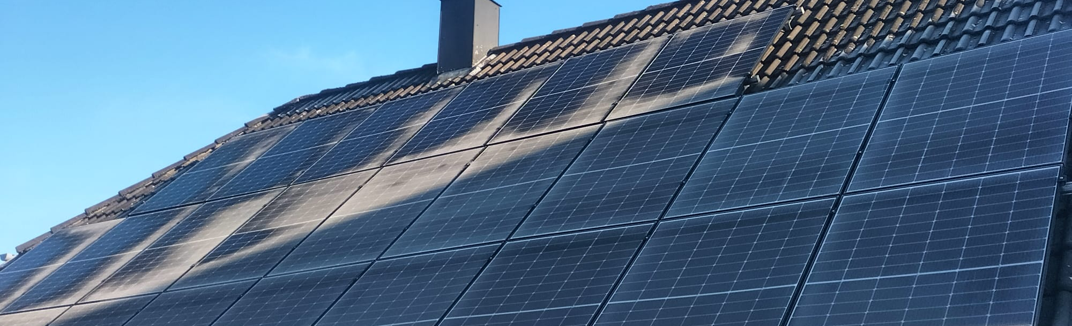
Renewable Energy Generation Prediction
Using Weather Data and Machine Learning
Christoph Emeis, Jessica Voß, Hossam Oraby
22.01.2026

Slide 2
Introduction
Problem:
Accurately predict daily solar PV power generation on privately owned solar plants using weather (forecast) data
→ Regression Task using time series
Using own data collections
Time period: Jun 2023- Jan 2026
Locations: Dobersdorf & Elmshorn
Use case:
When should I charge the electric car this week?

Slide 3
Literature Review
Paper name | Forecasting renewable energy for microgrids using machine learning (2025) | Towards Accurate Forecasting of Renewable Energy: Building Datasets and Benchmarking Machine Learning Models for Solar and Wind Power in France (2025)
Description | Generation prediction using local parameters | Nationwide generation prediction using weighted weather maps
Models | Baseline, CNN, LSTM | Random forest, Neural Network
Parameters/Variables | 7 (without sunlight data) | 10 (with solar radiation)
Focus of the analysis | Evalution metrics (RMSE, MSE, MAE) | Cross-validation (Hold-out, K-Fold, Blocking )
Best model | CNN | CNN
Reference | Discov Appl Sci 7, 449 (2025) | arXiv:2504.16100

Slide 4
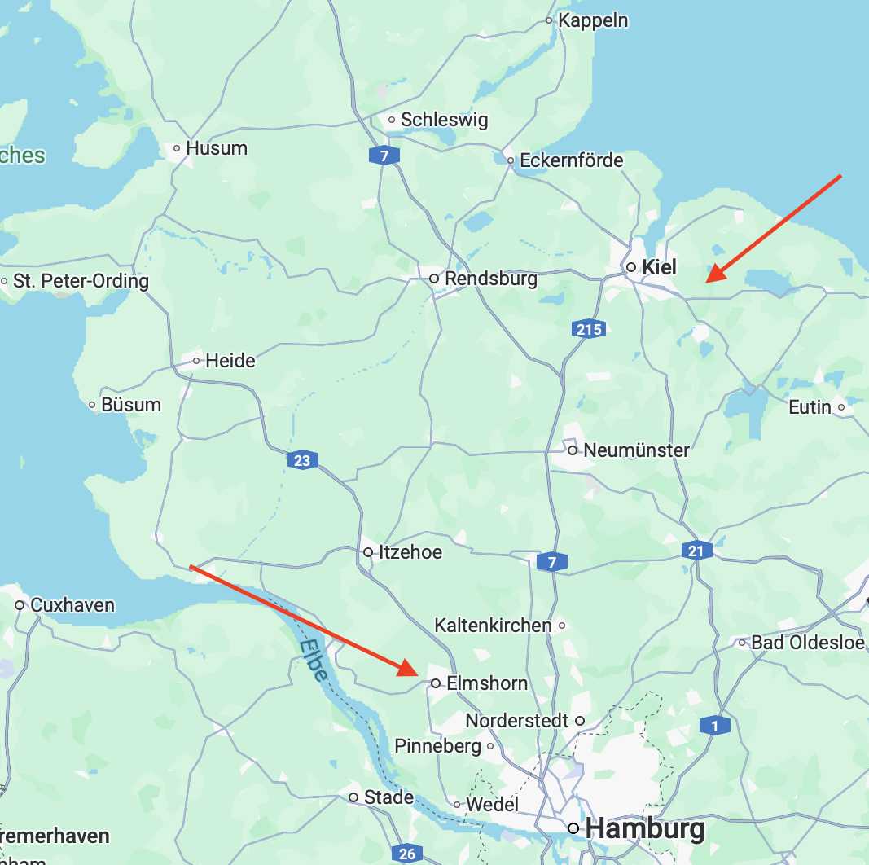
Dataset Characteristics
Locations: Elmshorn and Dobersdorf
The solar production of two privatly owned roof solar panels
Jun 2023- 15.01.2026
Obtained weather data from DWD (German Meteorological Service)
Chose the closed weather stations
Various measured parameters

Slide 5
Dataset Characteristics
Weather data:
Humidity
Solar radiation
Precipitation
Cloud Coverage
Sunshine duration
Pressure
Temperature
Energy Production:
Daily data (916 days)
0- 90 kWh daily generation
Missing values were set to 0
Machine Learning with Tensorflow
5

Slide 6
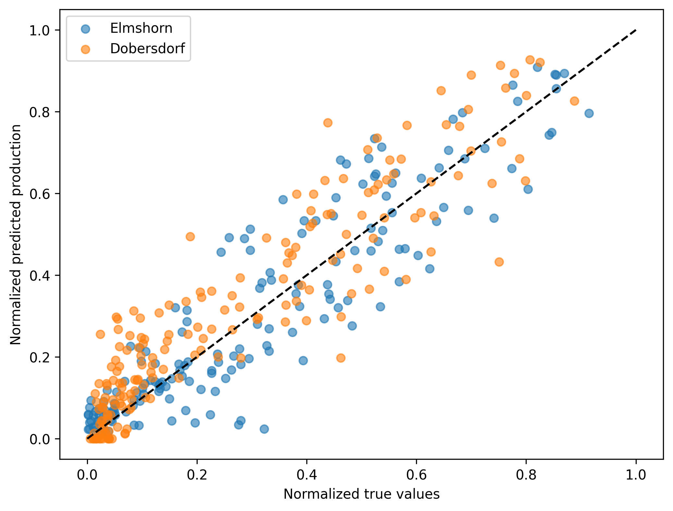
Baseline Models
Simple neural network:
2 Input variables
(mean temperature
& sunlight duration)
1 hiden layer with 2 nodes,
ReLU acctivation,
MAE, ADAM, lr=0.001
Run Time < 4s
Accuracy ~ 91%
Notes:
We also tried random forest!

Slide 7
Advanced Model - LSTM Architecture
Neural Network Architecture
Model Configuration
Input Layer
Optimizer
10-day time windows × 8 features
Adam (learning_rate=0.0001)
shape: (10, 8)
Loss Function
LSTM Layer 1
Mean Squared Error
LSTM(60, return_sequences=True)
60 units, preserves time dim
Metrics
MSE, MAE
LSTM Layer 2
LSTM(60)
60 units, final sequence
Why LSTM?
Captures temporal dependencies in weather patterns
Output Layer
Handles sequential relationships in time-series data
Dense(1)
single regression output
Maintains long-term memory of weather trends
Notes:
We also tried a complex NN, but it performed worse

Slide 8
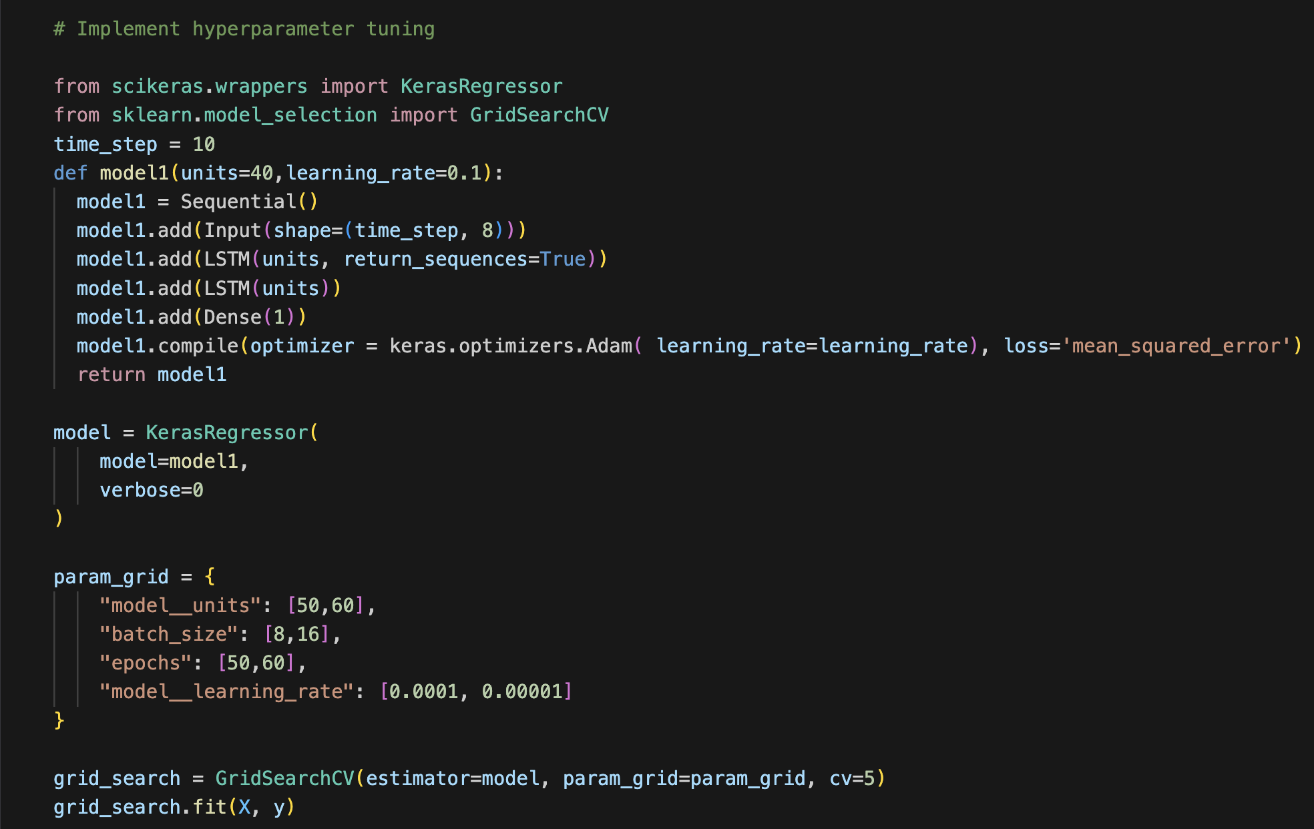
Advanced Model - Hyperparameter tuning
Best Configuration
Units
60
Batch Size
16
Epochs
60
Learning Rate
10-4

Slide 9
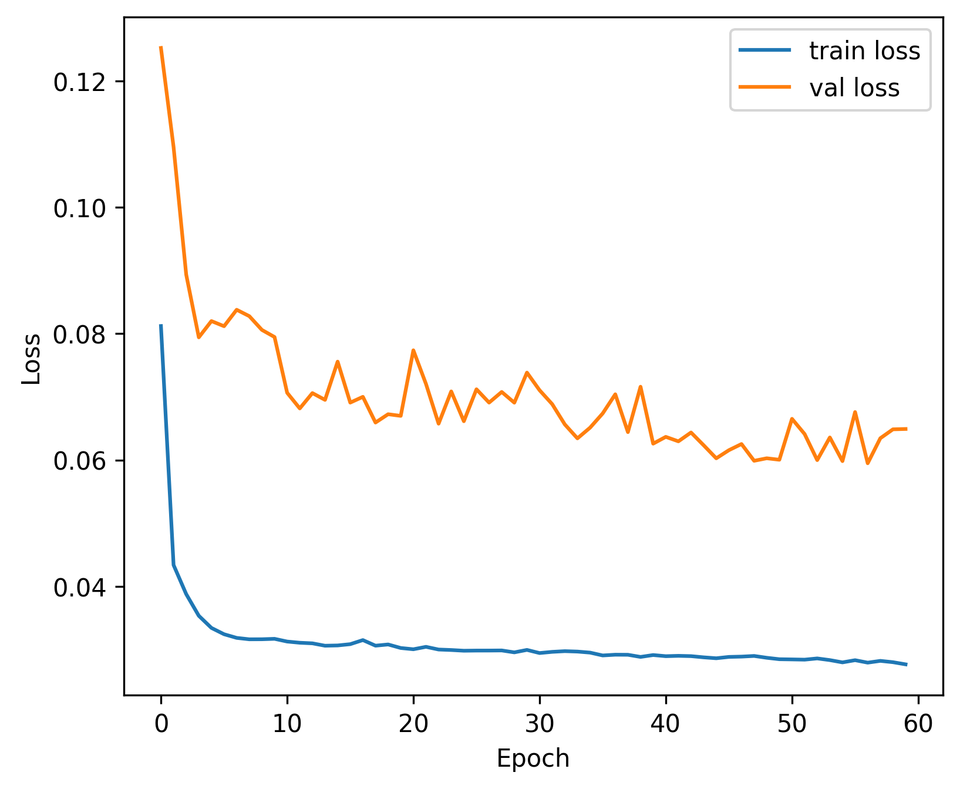
Advanced Model – Training process
Training Configuration
Epochs
Batch Size
60
16
Validation Split
Optimizer
15%
Adam

Slide 10
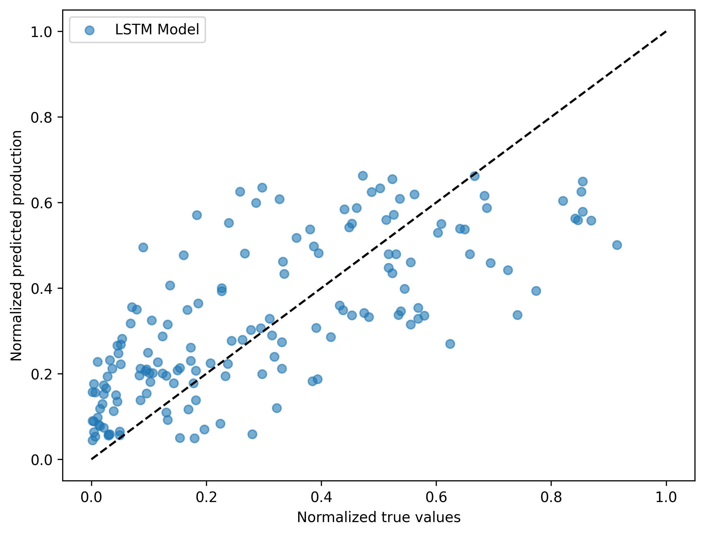
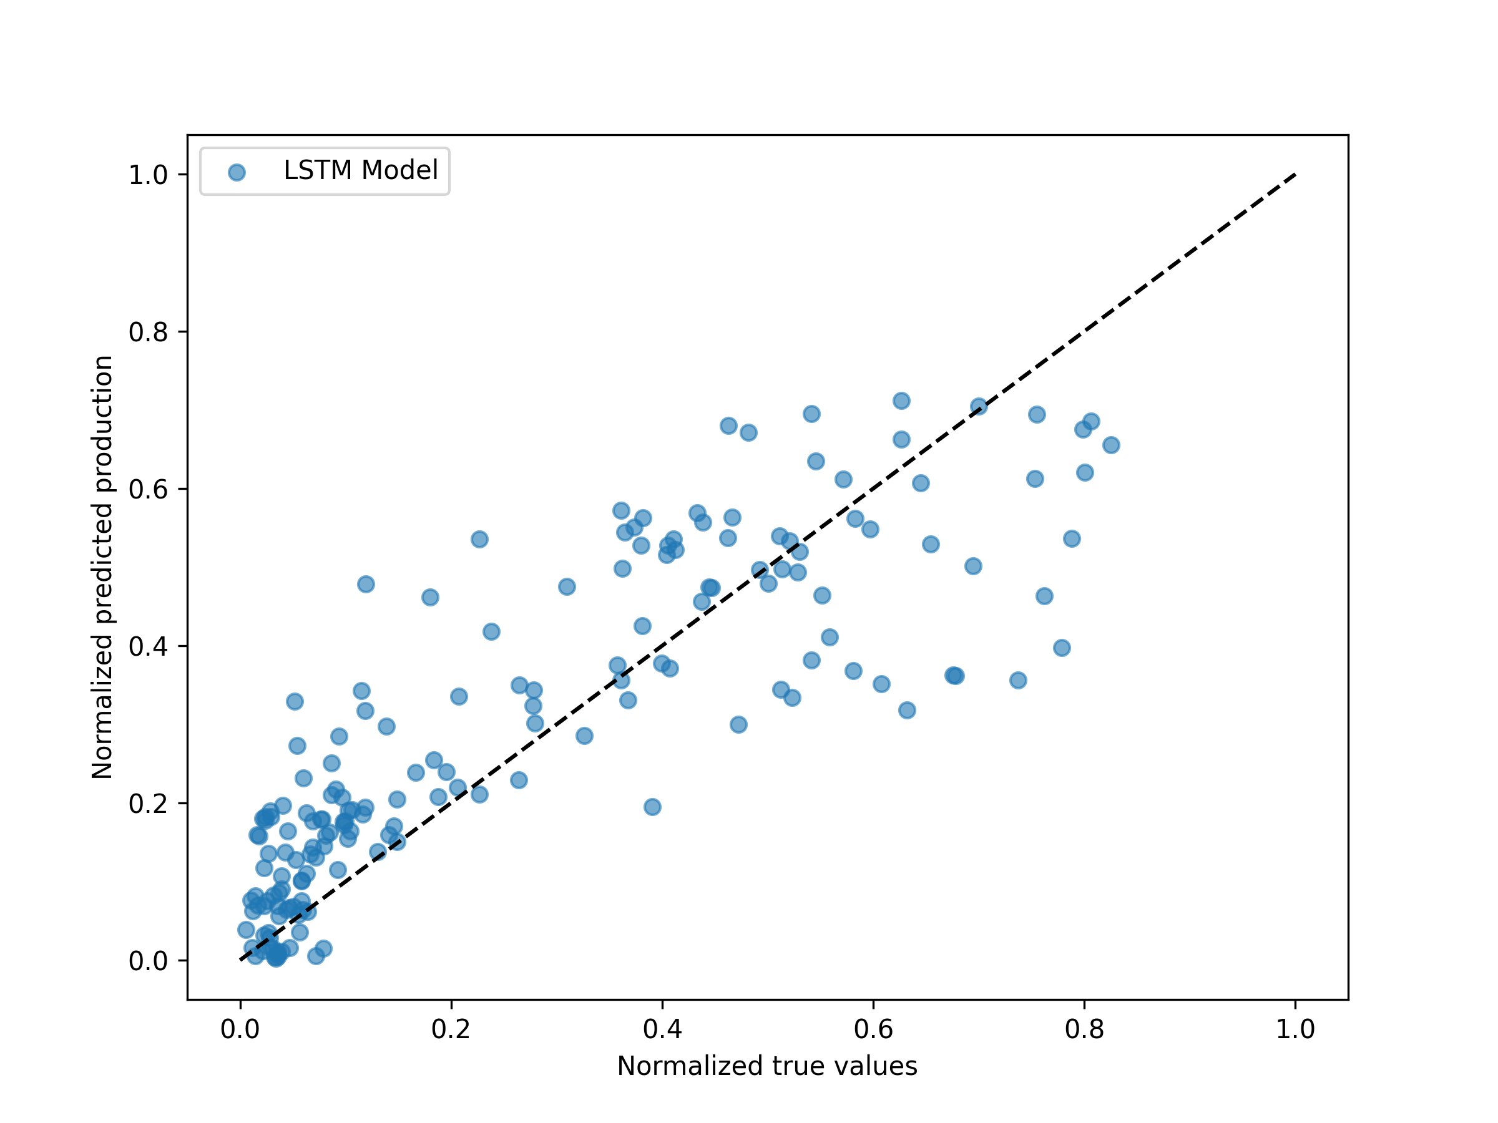
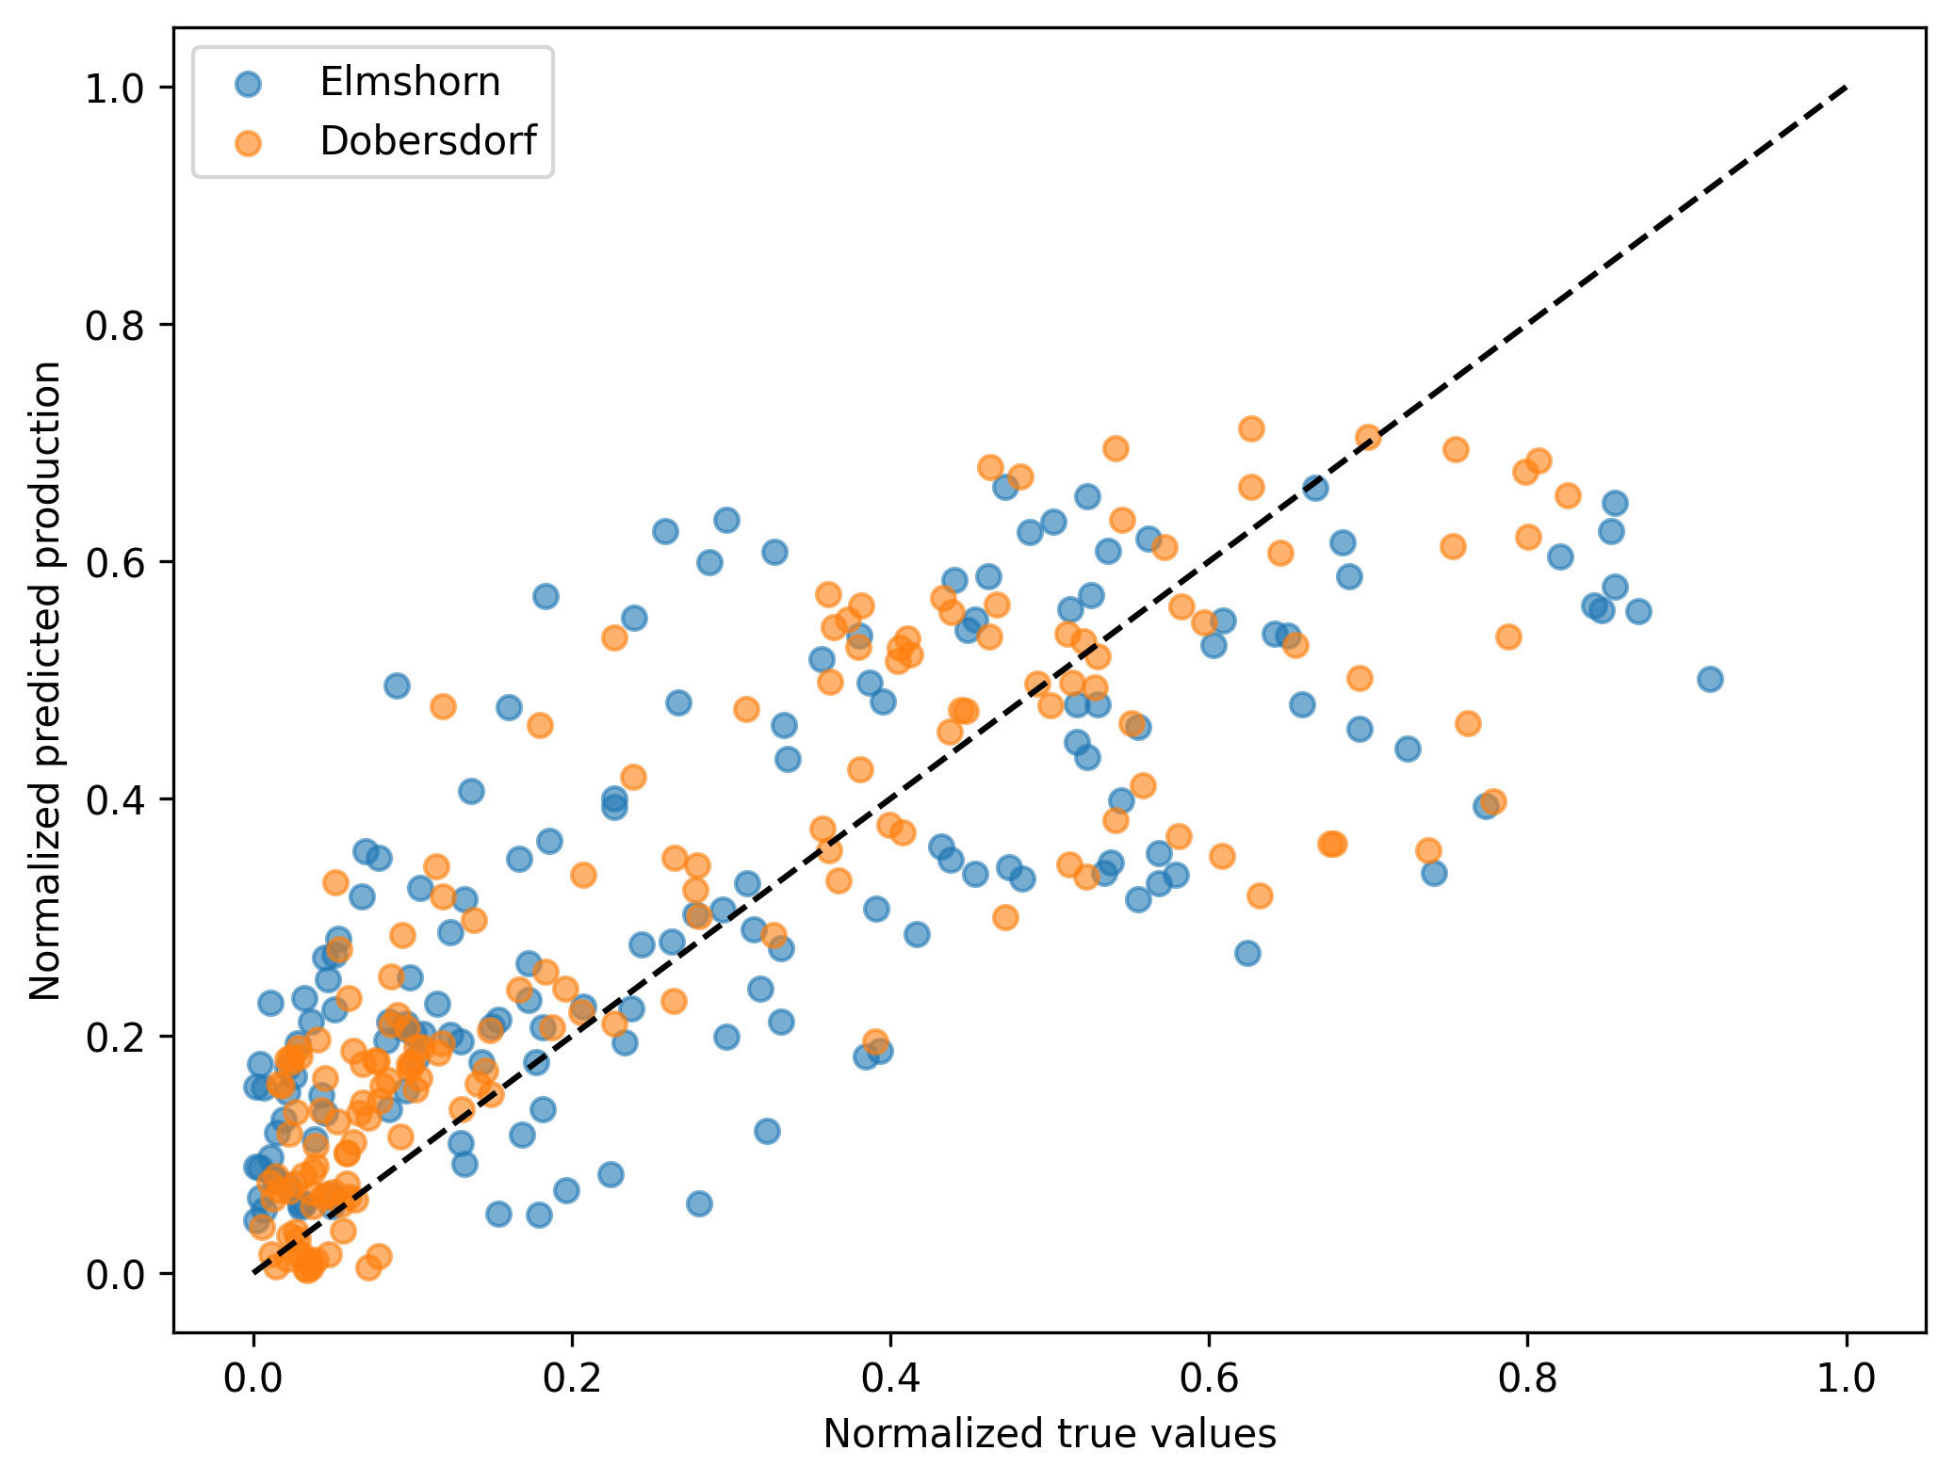
Advanced Model Performance
Elmshorn
Dobersdorf
Run Time < 20s
Accuracy ~ 85-88 %
Non-linear behaviour
→ bias
The models avoid predicting large value (>0.8)

Slide 11
Challenges and Errors
Hyperparameter tuning:
- Unsuccesfully tried different ways for hyperparametertuning
Data had wrong shape
Took a long time
Obtaining reliable data:
Only few weather station in SH that measure sunlight duration
→ We don’t know how reliable the weather data is
No comparability between our two locations
We decided to treat Elmshorn and Dobersdorf independently

Slide 12
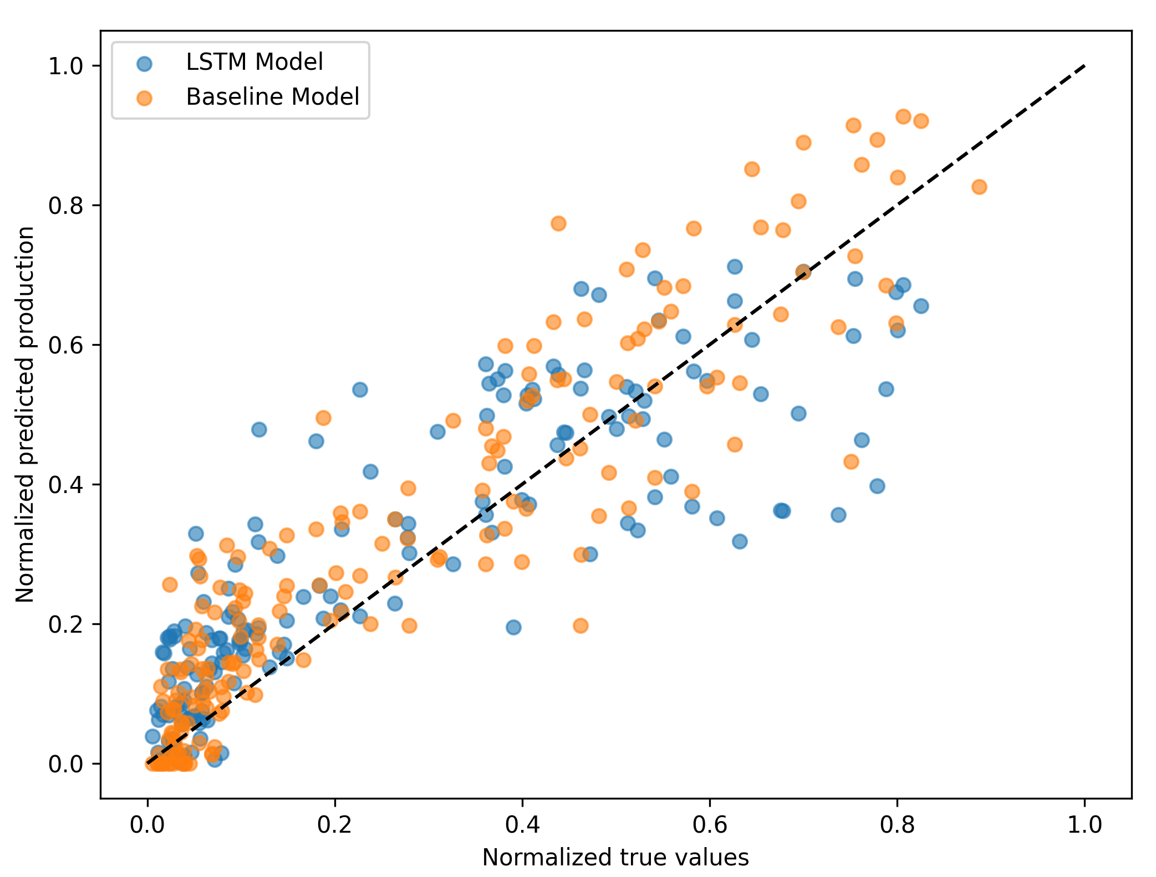
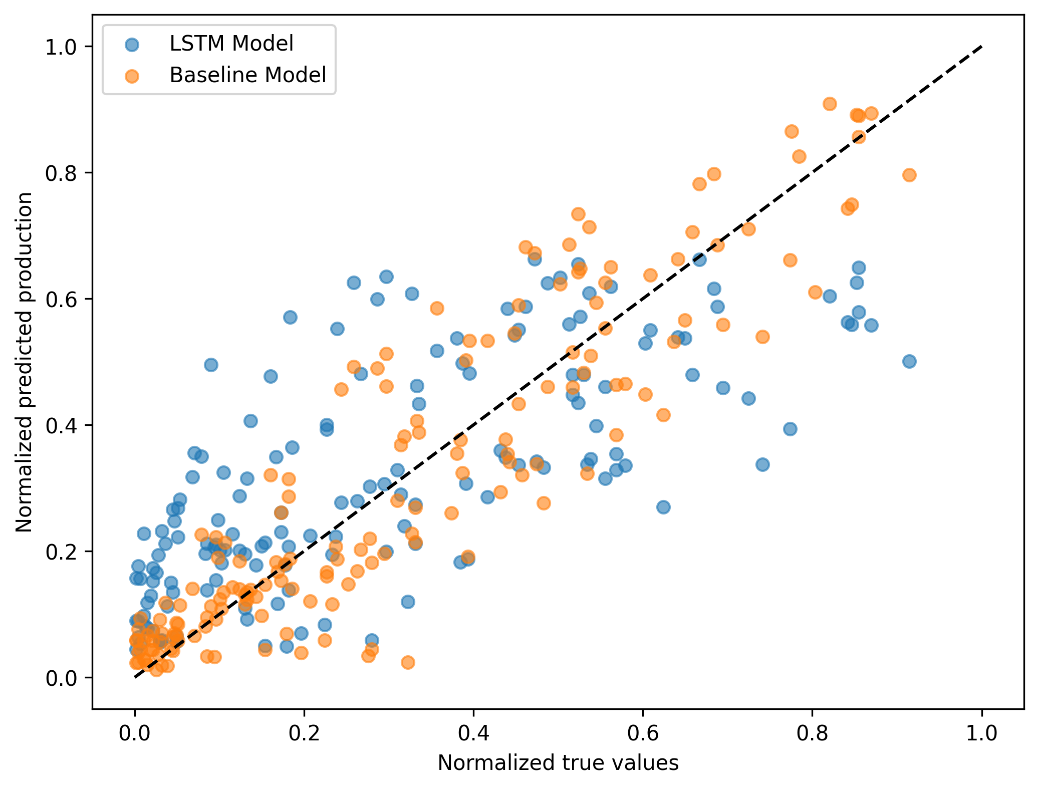
Discussion
Elmshorn
Dobersdorf
Simple vs. Complex model
How reliable is our weather data?
Weak prediction of high and low solar production
→ Not a big enough dataset?
How will the model be affected when using actual forecast data ?

Slide 13
Conclusion and Future Work
Both LSTM and Baseline NN performed quite well
→ Accuracy around 90%
Baseline even outperformed the LSTM
→ strongest features sunlight duration and temperature
Improve data situation
→ Use real forecast data for the actual locations
Increase time-resolution
→ Hourly or even shorter 10 min
View whole regions and contries → SH or Germany

Slide 14

Q&A
Thank you for your attention!
We are happy to answer questions ☺

Slide 15
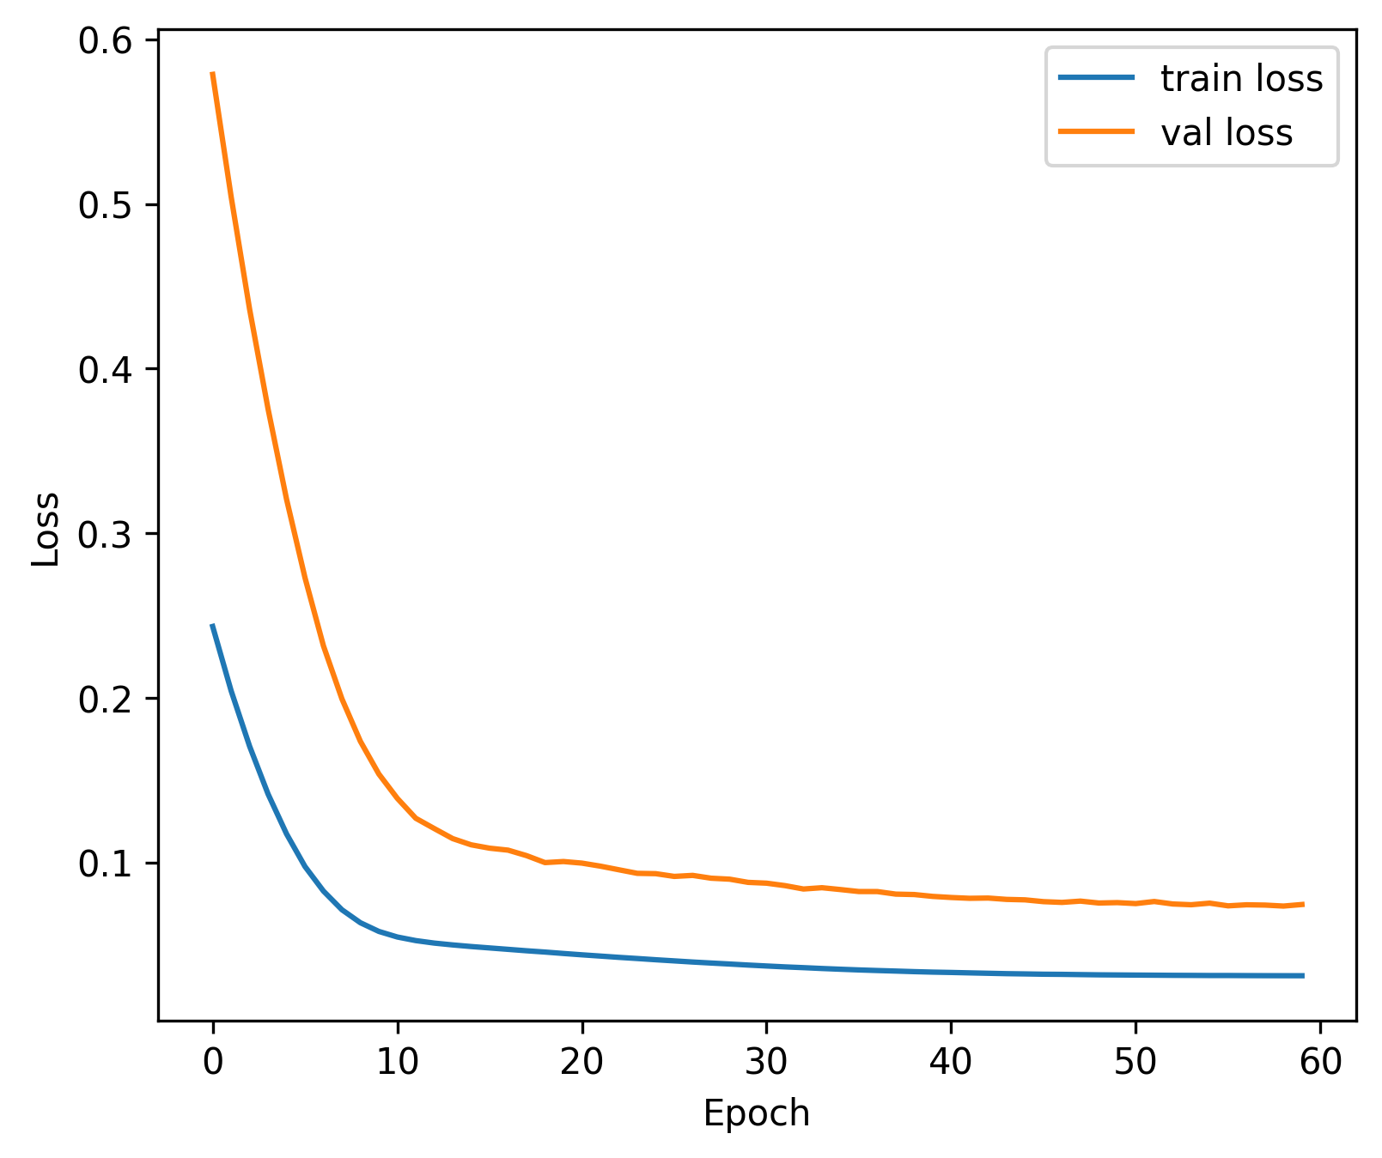
Advanced Model – Training process
Lr 0.00001 -> error around 14%
Training Configuration
Epochs
Batch Size
60
8
Validation Split
Optimizer
15%
Adam

Slide 16
Advanced Model Performance (Dobersdorf)
Run Time < 20s
Accuracy ~ 88 %
…

Slide 17
Advanced Model Performance (Elmshorn)
Run Time < 20s
Accuracy ~ 85 %
…

Slide 18
Discussion
Simple vs. Complex model
How reliable is our weather data?
Weak prediction of high and low solar production
→ Not a big enough dataset?
How will the model be affected when using actual forecast data ?

Slide 19
Dobersdorf
Elmshorn

